Slide 1
Welcome to the session on Political Thinkers of the Past
Hammurabi
Confucius,
Plato,
Aristotle,
Kautilya,
Ibn Khaldun,
Machiavelli,
Hobbes,
Lock,
Rousseau,
Karl Marx
Alexis de Tocqueville,

Slide 2
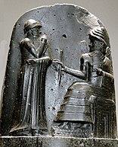
Political Philosophers
Hammurabi
Period : 1750 BC died
Main works
Hammurabi’s code
Theme/ philosophy
Law

Slide 3
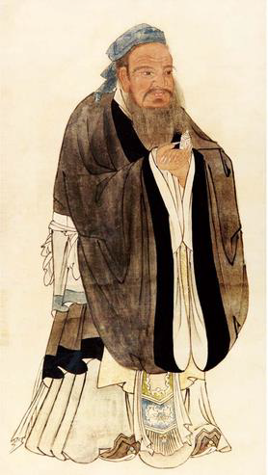
Political Philosophers
Confucius
Period : 600 BC

Slide 4
Confucius, according to Chinese tradition, was a thinker, political figure, educator, and founder of the Ru School of Chinese thought. Fung Yu-lan, one of the great 20thcentury authorities on the history of Chinese thought, compares Confucius' influence in Chinese history with that of Socrates in the West.

Slide 5
Confucius' political philosophy is also rooted in his belief that a ruler should learn self-discipline, should govern his subjects by his own example, and should treat them with love and concern.
“If the people be led by laws, and uniformity among them be sought by punishments, they will try to escape punishment and have no sense of shame. If they are led by virtue, and uniformity sought among them through the practice of ritual propriety, they will possess a sense of shame and come to you of their own accord”

Slide 6
It seems apparent that in his own day, however, advocates of more legalistic methods were winning a large following among the ruling elite. Thus Confucius' warning about the ill consequences of promulgating law codes should not be interpreted as an attempt to prevent their adoption but instead as his lament that his ideas about the moral suasion of the ruler were not proving popular.

Slide 7
Most troubling to Confucius was his perception that the political institutions of his day had completely broken down. He attributed this collapse to the fact that those who wielded power as well as those who occupied subordinate positions did so by making claim to titles for which they were not worthy.

Slide 8
When asked by a ruler of the large state of Qi, Lu's neighbor on the Shandong peninsula, about the principles of good government, Confucius is reported to have replied: “Good government consists in the ruler being a ruler, the minister being a minister, the father being a father, and the son being a son”

Slide 9
For Confucius, what characterized superior rulership was the possession of de or ‘virtue.’ Conceived of as a kind of moral power that allows one to win a following without recourse to physical force, such ‘virtue’ also enabled the ruler to maintain good order in his state without troubling himself and by relying on loyal and effective deputies.
Confucius claimed that, “He who governs by means of his virtue is, to use an analogy, like the pole-star: it remains in its place while all the lesser stars do homage to it”

Slide 10
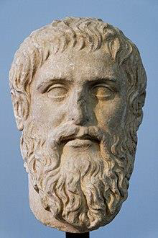
Political Philosophers
Plato
Period : 428-347BC
Main works
The Republic
Theme/ philosophy
Ideal state

Slide 11
Some scholars say Plato founded political science.
His masterpiece Republic described an ideal polis. But his ideas were not based on empirical observation. From today’s viewpoint it might look more like fascism or communism.

Slide 12
Plato’s Five Regimes (As in the Republic)
Aristocracy
Timocracy
Oligarchy
Democracy
Tyranny

Slide 13
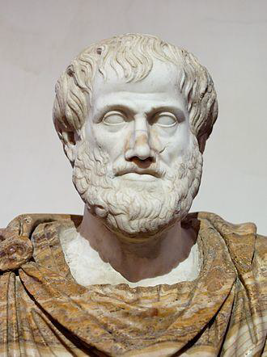
Political Philosophers
Aristotle
Period : 384-322 BC
Main works
Politics
Theme/ philosophy
democracy

Slide 14
Aristotle was a Greek philosopher, logician, and scientist. Along with his teacher Plato, Aristotle is generally regarded as one of the most influential ancient thinkers in a number of philosophical fields, including political theory.
Aristotle, a student of Plato, was a prolific researcher, teacher and writer. Known in the Middle Ages as simply “the Philosopher,” and called by Dante “the master of those who know,”

Slide 15
Aristotle's life seems to have influenced his political thought in various ways: his interest in biology seems to be expressed in the naturalism of his politics; his interest in comparative politics and his sympathies for democracy as well as monarchy may have been encouraged by his travels and experience of diverse political systems;

Slide 16
he criticizes harshly, while borrowing extensively, from Plato's Republic, Statesman, and Laws; and his own Politics is intended to guide rulers and statesmen, reflecting the high political circles in which he moved.

Slide 17
In the Nicomachean Ethics Aristotle describes his subject matter as ‘political science’, which he characterizes as the most authoritative science. It prescribes which sciences are to be studied in the city-state, and the others — such as military science, household management, and rhetoric — fall under its authority.

Slide 18
Aristotle's political science thus encompasses the two fields which modern philosophers distinguish as ethics and political philosophy. Political philosophy in the narrow sense is roughly speaking, the subject of his treatise called the Politics.

Slide 19
Politics is all around us. Aristotle called it the “master science” because it influences all aspects of human life: what we can do, what we can say, where we can live, even what we can eat. There is no escaping politics, but we can discover more effective ways to use it by studying Political Science.

Slide 20
The distinction between correct and deviant constitutions is combined with the observation that the government may consist of one person, a few, or a multitude. Hence, there are six possible constitutional forms (Politics III.7):
 | Correct | Deviant
One Ruler | Kingship | Tyranny
Few Rulers | Aristocracy | Oligarchy
Many Rulers | Polity | Democracy
:

Slide 21
The Politics
As Aristotle understands things, the heart of political activity is the regime (the constitution) because it forms the people and resources of a particular place into a whole whose laws and actions serve an understanding of virtue and happiness.
It is more significant than geography and resources or ethnic makeup, although such matters are significant.

Slide 22
One can see the importance of the regime by reflecting on the vast difference between Germany ruled by Nazi tyranny and Germany ruled democratically.

Slide 23
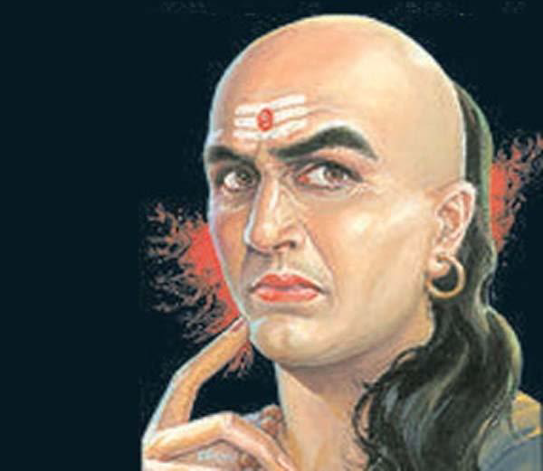
Political Philosophers
Kautillay/Chanakya
Period : 350-283 BC
Main works
Arthashastra

Slide 24
Two millenia before Machiavelli and Hobbes, the Indian writer Kautilya in the fourth century B.C. arrived at the same conclusion.
Kautilya was a prime minister and advisor to the Indian monarch Chandragupta Maurya wrote his book Arthashastra that prosperity comes from living in a well run kingdom.
Like Hobbes, Kautilya posited a state of nature that meant anarchy

Slide 25
Monarchs arose to protect the land and people against anarchy and ensure their prosperity.
Like Machiavelli, Kautilya advised his prince to operate on the basis of pure expediency, doing whatever it takes to secure his kingdom domestically and against other kingdoms.
He could be termed as the founder of political economy and the founder of realist school of statecraft.

Slide 26
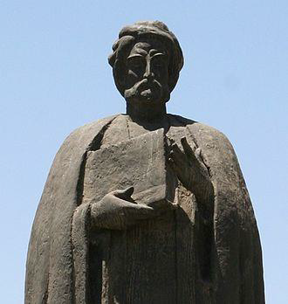
Political Philosophers
Ibn Khaldun
Period : 1332-1406
Main works
Al Mukaddima

Slide 27
Ibn Khaldūn, in full Walī al-Dīn ʿAbd al-Raḥmān ibn Muḥammad ibn Muḥammad ibn Abī Bakr Muḥammad ibn al-Ḥasan Ibn Khaldūn, (born May 27, 1332, Tunis [Tunisia]—died March 17, 1406, Cairo, Egypt), the greatest Arab historian, who developed one of the earliest nonreligious philosophies of history, contained in his masterpiece, the Muqaddimah (“Introduction”). He also wrote a definitive history of Muslim North Africa. Ibn Khaldūn was born in Tunis in 1332; the Khaldūniyyah quarter in Tunis still stands almost unchanged and, in it, the house where he is believed to have been born. As Ibn Khaldūn relates in his autobiography (Al-taʿrīf

Slide 28
Abd al-Rahman Ibn Khaldun (generally known as “Ibn Khaldun,” or son of Khaldun), born in North Africa in the fourteenth century, is renowned for being one of the leading political theorists and historians produced by Islam.
His masterpiece, Muqaddimah (Introduction), which contains a theory of universal history that is still respected today, is thought to be the first work of historiography and a precursor to the modern disciplines of anthropology, sociology, economics, and political science.

Slide 29
As a historian, scholar, lawyer, theologian, mathematician, military strategist, philosopher, and social scientist, Ibn Khaldun had a deep and enduring influence on the development of Islamic political ideology, and indeed on the development of historical and political thought more generally.

Slide 30
Ibn Khaldun was secretary, executive and ambassador for several rulers. Sometimes out of favour and in jail, he reflected on what had gone wrong with the great Arab empire.
He concluded, in his `Universal History’ that the character of the Arabs and their social cohesiveness were determined by climate and occupation. Ibn Khaldun was almost modern in his linking of underlying conditions to social and political change.

Slide 31
Economic decline in North Africa, he found, had led to political instability and lawlessness. Anticipating Marx, Toynbee and many other Western writers, Ibn Khaldun saw that civilizations pass through cycles of growth and decline.

Slide 32
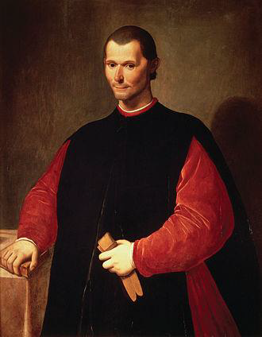
Political Philosophers
Niccolo Machiavelli
Period: 1469-1527
Main works
Prince

Slide 33
He was the first to focus on power as the main force of political science. His magnum opus The Prince was based mainly on getting and using power.
Some philosophers consider Machiavelli to be the first modern philosopher because his motivations and explanations had nothing to do with religion.

Slide 34
Machiavelli is largely misunderstood as a prophet of wickedness regarding statecraft.
He was actually a realist who thought that the Prince had to be rational and tough to accomplish the political goals.

Slide 35
Machiavelli uses the metaphor of the fox and the lion to explain the combination of cunning and strength that a prince must possess in order to maintain control of his state. Machiavelli stresses that a prince must learn how to imitate both the fox and the lion so that he may draw on the necessary attributes of these "beasts" when circumstances demand it.

Slide 36
According to Machiavelli, a prudent ruler must adapt to new situations and problems, acting as a fox "in order to recognize traps" and as a lion when he must "frighten off wolves." Machiavelli argues that the lion "is defenseless against traps" while the fox "is defenseless against wolves" and other physical threats.
Therefore, a prince must mimic the behavior of both types of beasts in order to benefit from their complementary talents and to overcome their differing weaknesses.

Slide 37
As a fox, the prince can use cunning statecraft and diplomacy to sidestep traps and other pitfalls. As a lion, the prince can use physical force in order to maintain his power over his subjects and enemies. Taken individually, neither of these talents will spell a prince's success; but combined, the diversified skill set – political cunning backed by the threat of physical force – is formidable.
The fox and the lion represent a meeting of opposites and a wise ruler will strive to master and combine the unique skills of both beasts.

Slide 38
Theories of Social Contract
The Contractualists Hobbes, Locke and Rousseau analysed why political systems should exist at all. They differed in many points but agreed that humans, at least in principle, had joined in what Rousseau called a social contract that every one now had to observe.

Slide 39
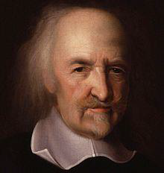
Political Philosophers
Thomas Hobbes
Period : 1225-1274
Main Works
Leviathan

Slide 40
Thomas Hobbes lived through the English Civil War and opposed its tumult for making individuals frightened and insecure. Hobbes imagined that life in the `state of nature’ before civil society was founded, must have been terrible. Every man would have been the enemy of every other man.

Slide 41
Humans would live in savage squalor with “no arts, no letters; no society; and which is worst of all continual fear and danger of violent death; and the life of man, solitary, poor, nasty, brutish and short”.
To get out of this horror people would, out of profound self-interest- rationally join together to form civil society

Slide 42
Society thus arises naturally out of fear.
People would also gladly submit to a king, even a bad one, for a monarch prevents anarchy.
Hobbes theory is based on rational self interest.
This theory is at odds with that of Aristotle who said that humans are born `political animals’.

Slide 43
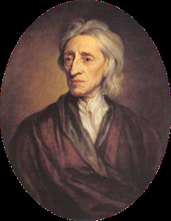
Political Philosophers
John Locke
Period : 1632-1704
Main Works
Two Treatises of Government

Slide 44
John Locke also saw the seventeenth century upheavals but came to less harsh conclusions.
Locke theorized that the original state of nature was not so bad; people lived in equality and tolerance with one another. But they could not secure their property.
There was no money, title deeds or courts of law, so ownership was uncertain.

Slide 45
To remedy this they contractually formed civil society and thus secured “life, liberty and property.”
Locke is to property rights as Hobbes is to fear of violent death.
Some philosophers argue that Americans are the children of Locke.

Slide 46
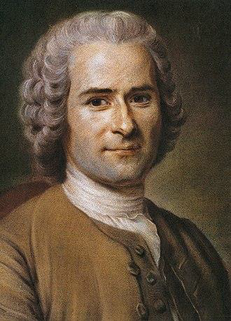
Political Philosophers
Jean-Jacques Rousseau
Period : 1712-1788
Main Works
Social Contract

Slide 47
Jean-Jacques Rousseau laid the philosophical groundwork for the French Revolution.
He accepted the theories of Hobbes and Locke but gave them a twist. He said that the life in the state of nature was downright good; people lived as “noble savages” without artifice or jealousy.
He said that society itself corrupted humans.

Slide 48
His Social Contract says at the beginning:
“Man is born free but everywhere is in chains”

Slide 49
He said society can be drastically improved leading to human freedom. A just society would be a voluntary community with a will of its own, the general will.
Societies make people – not the other way round. If people are bad, it is because society made them that way

Slide 50
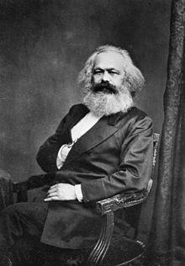
Political Philosophers
Karl Marx
Period : 1818-1883
Main works
Das Capital

Slide 51
Another political theory that made a big difference was Marxism.
Karl Marx, German trained in Hegelian philosophy propounded a theory based on a theory of economics, a theory of social class and a theory of history.
Marx argued that things do not happen by accident, everything has a cause.

Slide 52
Marx concentrated on `surplus value’ what others call profit. Workers produce things but get paid only a fraction of the value of what they produce.
The capitalist owners skim off the rest, the surplus value.
The working class, the proletariats, is paid too little to buy all the products the workers have made, resulting in repeated overproduction.

Slide 53
Eventually there will be a depression so big the capitalist system will collapse
Social class
Every society has two classes. One that owns the means of production and the other much larger class that work for the small class.
Society is run according to the dictates of the upper class.
The proletariat has no country

Slide 54
History
Combining his theories on economics and social classes, Marx explained historical changes.
When the economic forces crack at the infrastructural level, the dominant superstructure collapses as happened in the case of the French Revolution.

Slide 55
Marx`s enduring contributions:
His understanding that societies are never fully unified and peaceful but always riven with conflict and struggle.
In any political controversy we must ask, `Who benefits?’

Slide 56
Marx erred in a couple of ways
He failed to understand the flexible, adaptive nature of capitalism. Old industries fade and new ones rise.
Marx failed to understand that capitalism is not just one system; it is many. U.S., French, Singaporean and Japanese capitalisms are distinct from each other.

Slide 57
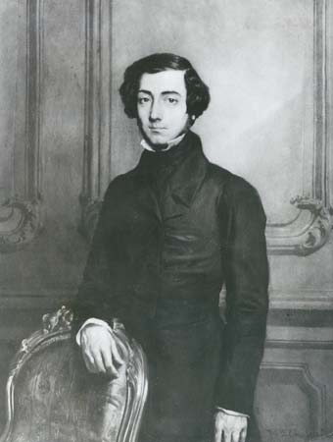
Political Philosophers
Alexis de Tocqueville
Period: 1805- 1859
Main Works
Democracy in America

Slide 58
Political scientist, historian, and politician, best known for Democracy in America, 4 vol. (1835–40), a perceptive analysis of the political and social system of the United States in the early 19th century.

Slide 59
In Democracy in America, published in 1835, Tocqueville wrote of the New World and its burgeoning democratic order.
Observing from the perspective of a detached social scientist, Tocqueville wrote of his travels through America in the early 19th century when the market revolution, Western expansion, and Jacksonian democracy were radically transforming the fabric of American life.

Slide 60
One purpose of writing Democracy in America, according to Joshua Kaplan, was to help the people of France get a better understanding of their position between a fading aristocratic order and an emerging democratic order, and to help them sort out the confusion.
Tocqueville saw democracy as an equation that balanced liberty and equality, concern for the individual as well as for the community.

Slide 61
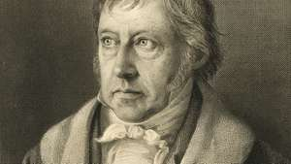
Georg Wilhelm Friedrich Hegel
German philosopher
Georg Wilhelm Friedrich Hegel, German philosopher who developed a dialectical scheme that emphasized the progress of history and of ideas from thesis to antithesis and thence to a synthesis.

Slide 62
END OF SESSION

